Slide 1



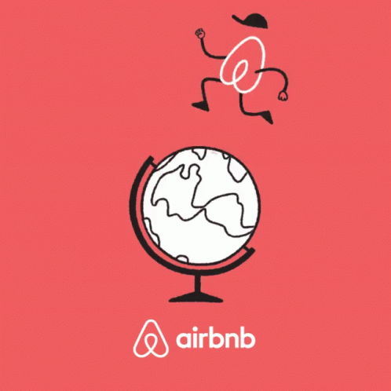
airbnb
By olivia

Slide 2


Founder of airbnb
Airbnb was founded by Brian Chesky, Joe Gebbia, and Nathan Blecharczyk.
Their journey began when Brian and Joe, struggling to make rent, had the idea to rent out air mattresses in their San Francisco apartment to attendees of a design conference, which sparked the concept of "Air Bed and Breakfast". Later, Nathan Blecharczyk joined the team to help develop the website and build the business. The initial idea was to create a platform for booking unique and affordable accommodations globally.
Today, Airbnb has grown into a major player in the hospitality and tourism industry, allowing people to rent out various types of accommodations, from rooms and apartments to entire homes and unique spaces like castles or yachts.

Slide 3


Why did Brian Chesky, Joe Gebbia, and Nathan Blecharczyk start the company
A Design Conference in San Francisco and Sold-Out Hotels: The pair noticed that a design conference in San Francisco had caused all the local hotels to become completely booked, creating a demand for temporary housing.
Initial Success and Realization of Potential: They quickly found three guests who were willing to pay to stay on the air mattresses, which helped them cover their rent and also highlighted the potential of their idea.
Early Challenges and the "Cereal Boxes" Solution: Despite some initial difficulties in gaining traction and attracting investors, they famously raised funds by selling limited edition, election-themed cereal boxes (Obama O's and Cap'n McCains).

Slide 4


what industry is airbnb in
Hospitality/Travel Services: At its core, Airbnb facilitates lodging and accommodations for travelers, putting it squarely in the hospitality sector. They connect guests seeking places to stay with hosts offering diverse accommodations like apartments, houses, unique stays like treehouses and castles, and even boutique hotels.
Sharing Economy: Airbnb is a prime example of the sharing economy model. It enables individuals to share their underutilized assets (spare rooms, homes) with others through an online platform, fostering a peer-to-peer rental system.

Slide 5

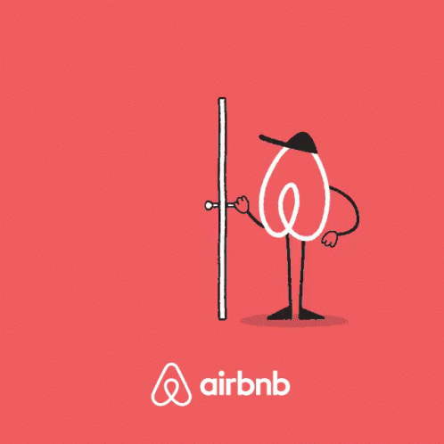
is airbnb publicly traded
Yes, Airbnb is publicly traded. It trades on the NASDAQ stock exchange under the ticker symbol ABNB.
Airbnb went public on December 10, 2020. The company's initial public offering (IPO) was priced at $68 per share. On its first day of trading, the stock opened at $146 per share.

Slide 6



Airbnb was producing revenue
Yes, Airbnb was producing revenue in 2021. The company's total revenue for the year 2021 was reported as $5.99 billion. This represents a substantial increase compared to the previous year, with a reported growth of 77.37% over 2020 revenue. The strong
Despite the challenges posed by the ongoing COVID-19 pandemic, 2021 proved to be a remarkable year for Airbnb, showcasing the resilience of its business model.

